Slide 1


Data-Driven Decisions: An Analytical Approach

Slide 2


Today's agenda
Project recap
Problem
The Analytics team
Process
Insights
Summary

Slide 3

Social Buzz have scaled quicker than anticipated and need the help of an advisory firm to oversee their scaling process effectively.
Accenture has started 3 months engagement
with Social Buzz to fulfill following demands: - An audit of Social Buzz’s big data practice.
- Recommendations for a successful IPO
- An analysis of Social Buzz’s top 5 categories with the largest popularity in their content.
Project Recap

Slide 4

Every day over 100,000 pieces of content, ranging from text, images, videos and GIFs are posted!
How to capitalize with such huge data having 36,500,000 pieces of content per year.
Analysis to find top 5 categories in popularity in their content.
Problem

Slide 5



Andrew Fleming
Chief Technology Architect
The Analytics team
Marcus Rompton
Senior Principal
Sushant Londhe
Data Analyst

Slide 6
Process
1
Data Understanding
2
Data Cleaning
3
Data Modelling
4
Data Analysis
5
Uncover Insights

Slide 7

Insights
16
1897
MAY
Unique Categories
Reaction to “Animal” Posts
Month with most Posts

Slide 8
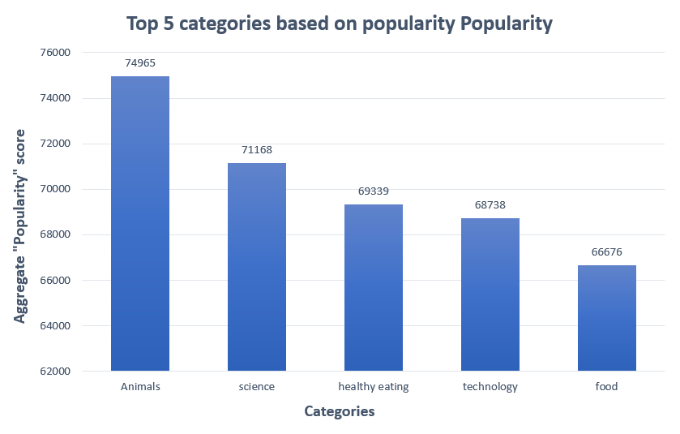

Slide 9
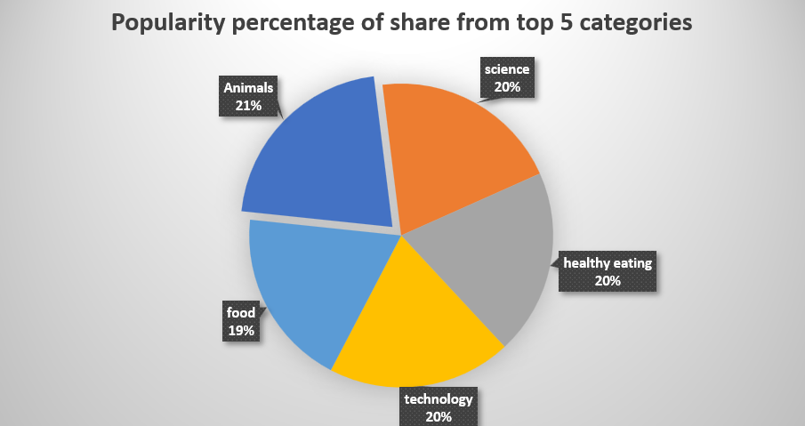

Slide 10

ANALYSIS
Animal and science are two most popular categories, showing that people are interested in “real - life” and “technology” content the most.
INSIGHTS
“Healthy-eating” is the 3rd highest category, this shows that we should work with more healthy food brands to boost user engagement.
Summary
NEXT STEP
This Analysis is insightful but now it’s time to implement it to real life projects. We can help you in these process.

Slide 11
Thank you!
ANY QUESTIONS?

